Slide 1
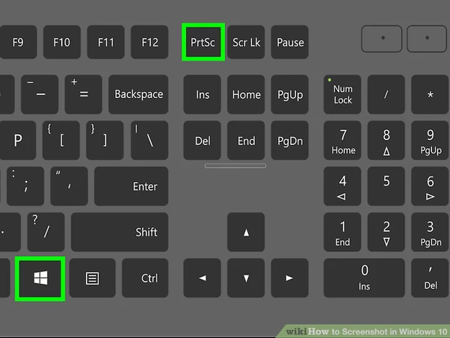
Task A: Project Management Screenshots

Slide 2
Communication

Slide 3
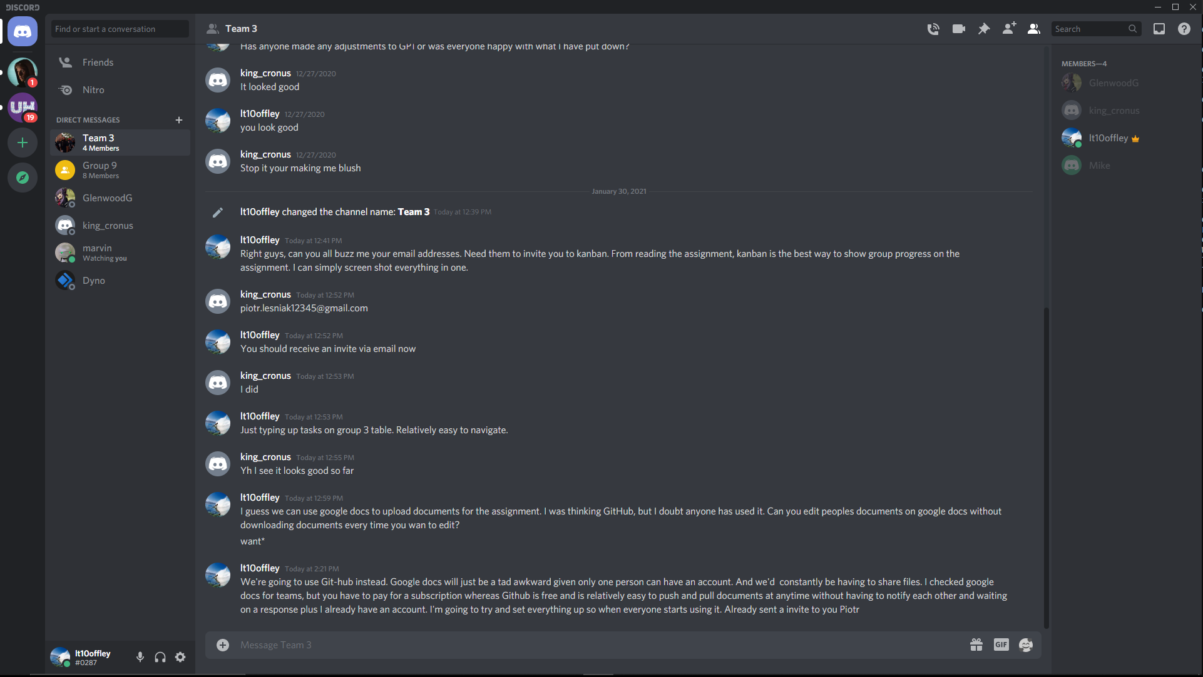
Created a Group Chat with 4 members including Lewis Taylor, Michael Olatunji, Piotr Lesniak, Kellen Pearton and still awaiting confirmation for Jorden Manning. Currently added Piotr to Kanban and has accepted the invite. Waiting on response from the rest of team Date: [30/01/2021]

Slide 4
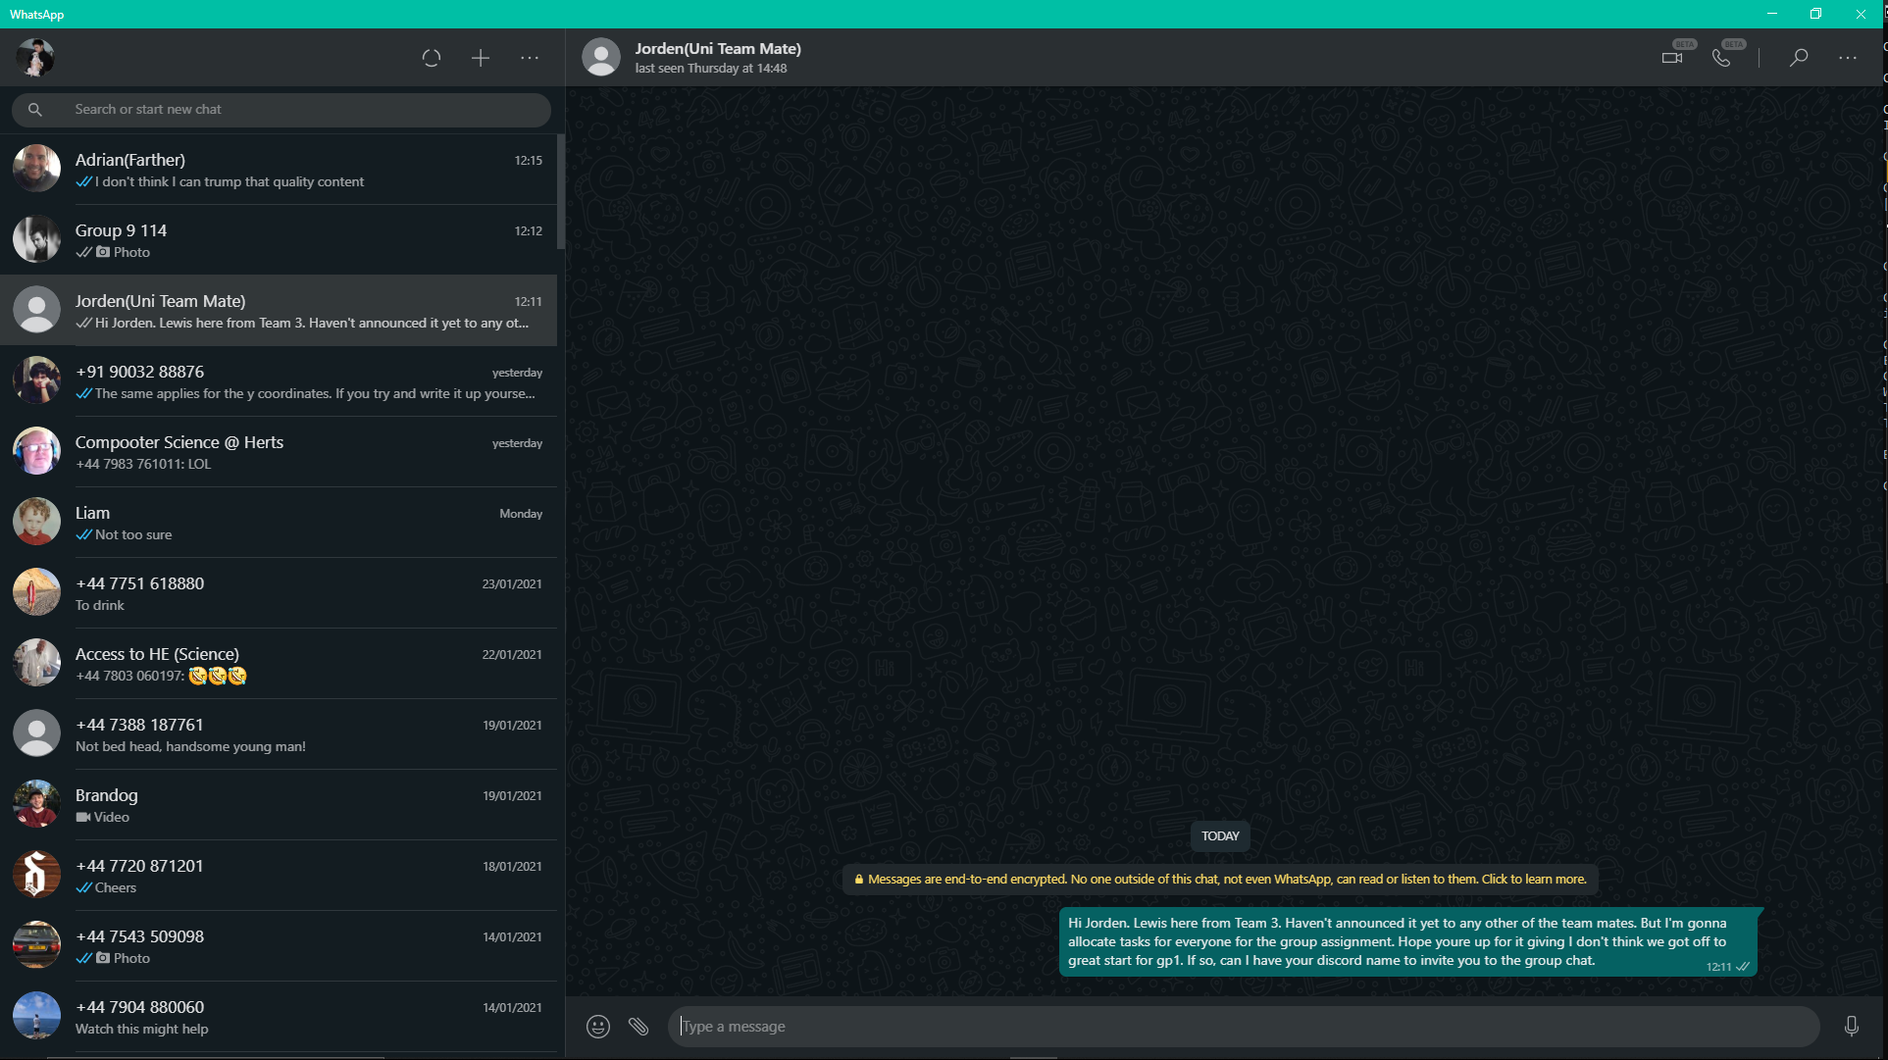
Currently trying to establish contact with Jorden Manning so that he can be added to the group chat. Everyone else has been informed on updates regarding invites to Kanban and GitHub via Discord.

Slide 5
Kanban

Slide 6
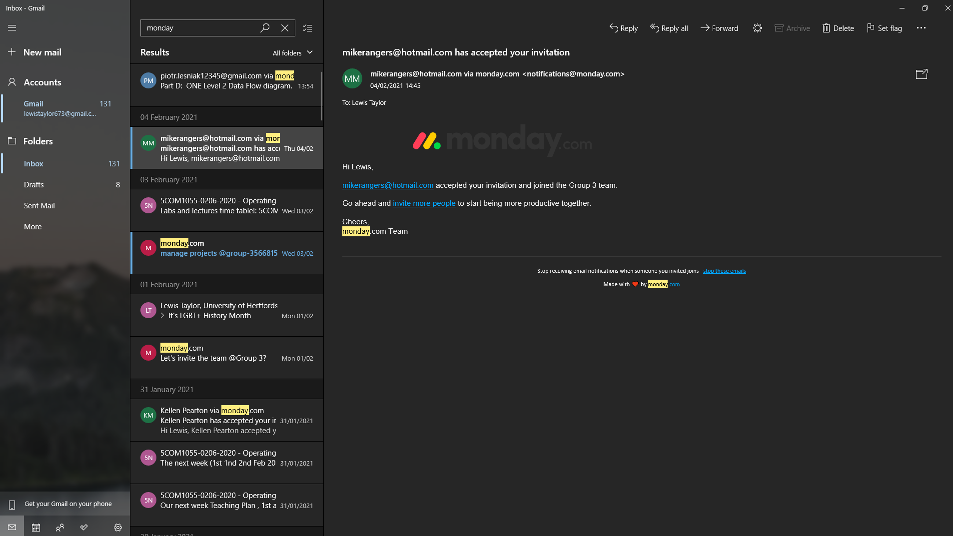
First accepted invite from Michael to Kanban as a collaborator.

Slide 7
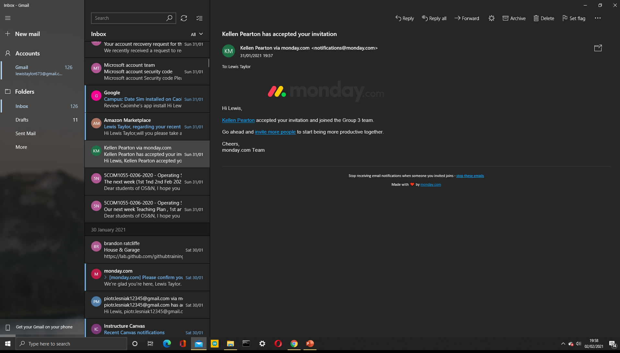
First accepted invite from Kellen to Kanban as a collaborator.

Slide 8
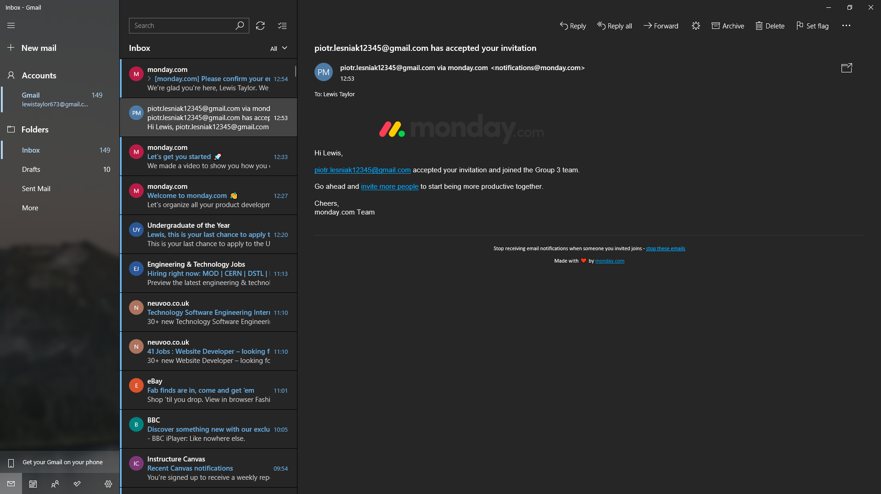
First accepted invite from Piotr to Kanban as a collaborator.

Slide 9
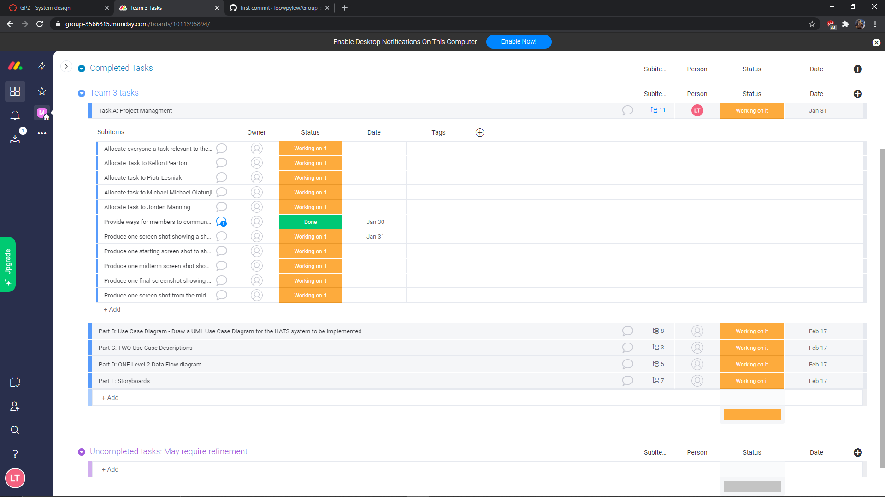
As we can see here, each Task has as series of subtasks which need to be completed in order for the main task status to be registered ;

Slide 10
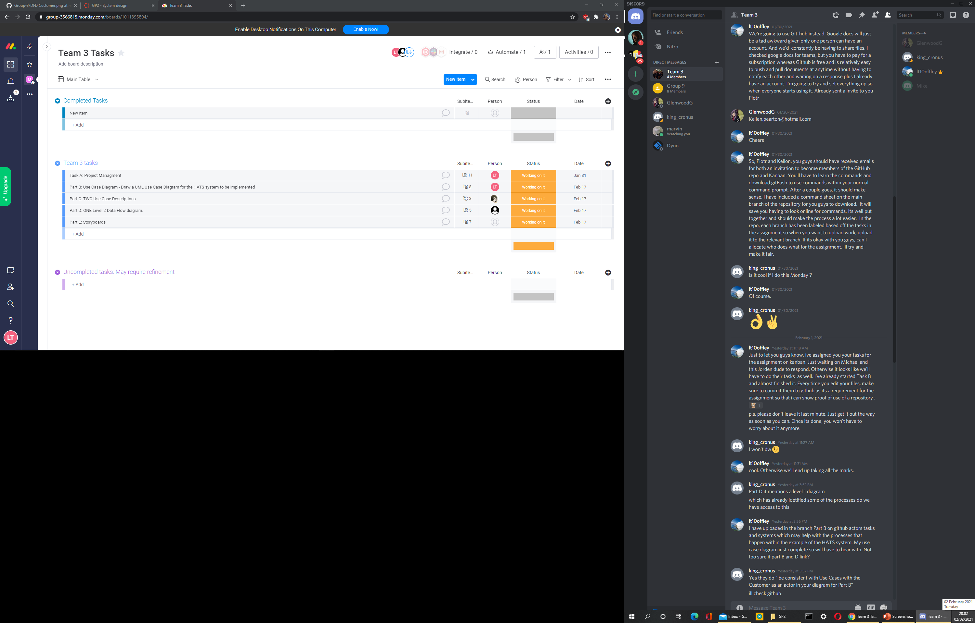
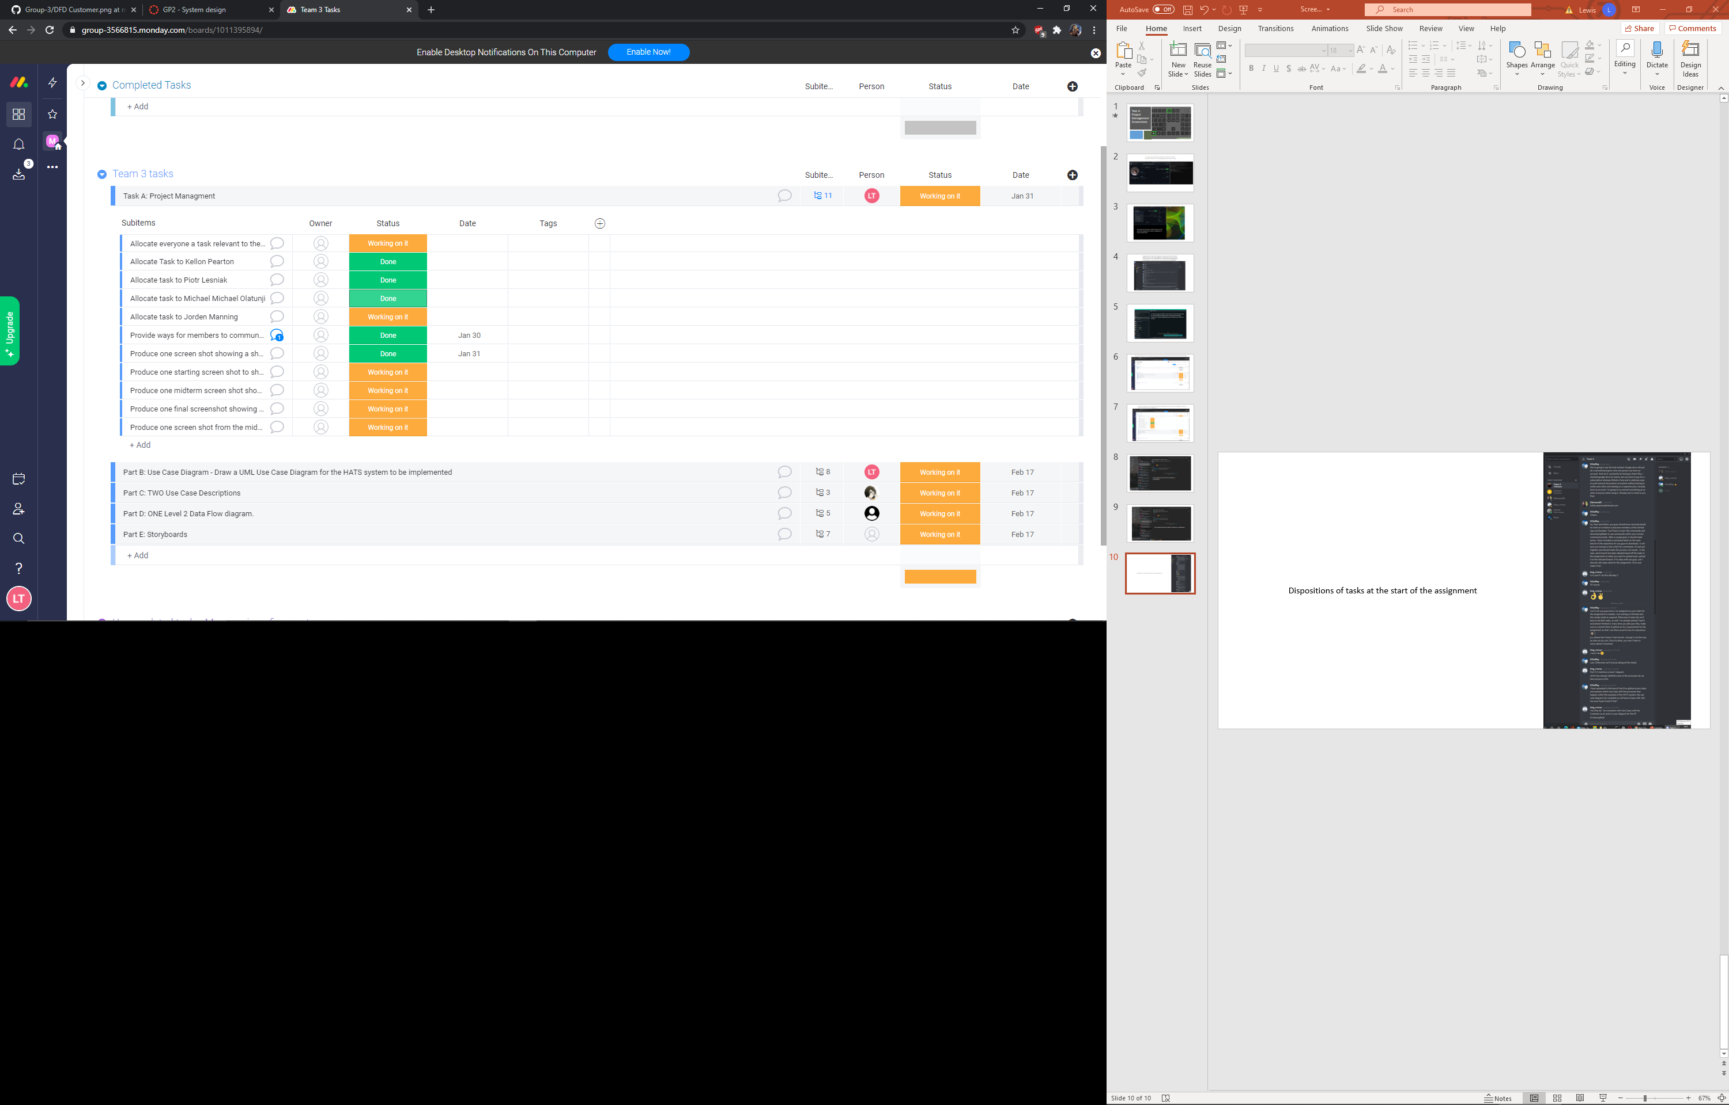
Announcement of dispositions of tasks at the start of the assignment -
Dispositions of tasks at the start of the assignment ^

Slide 11
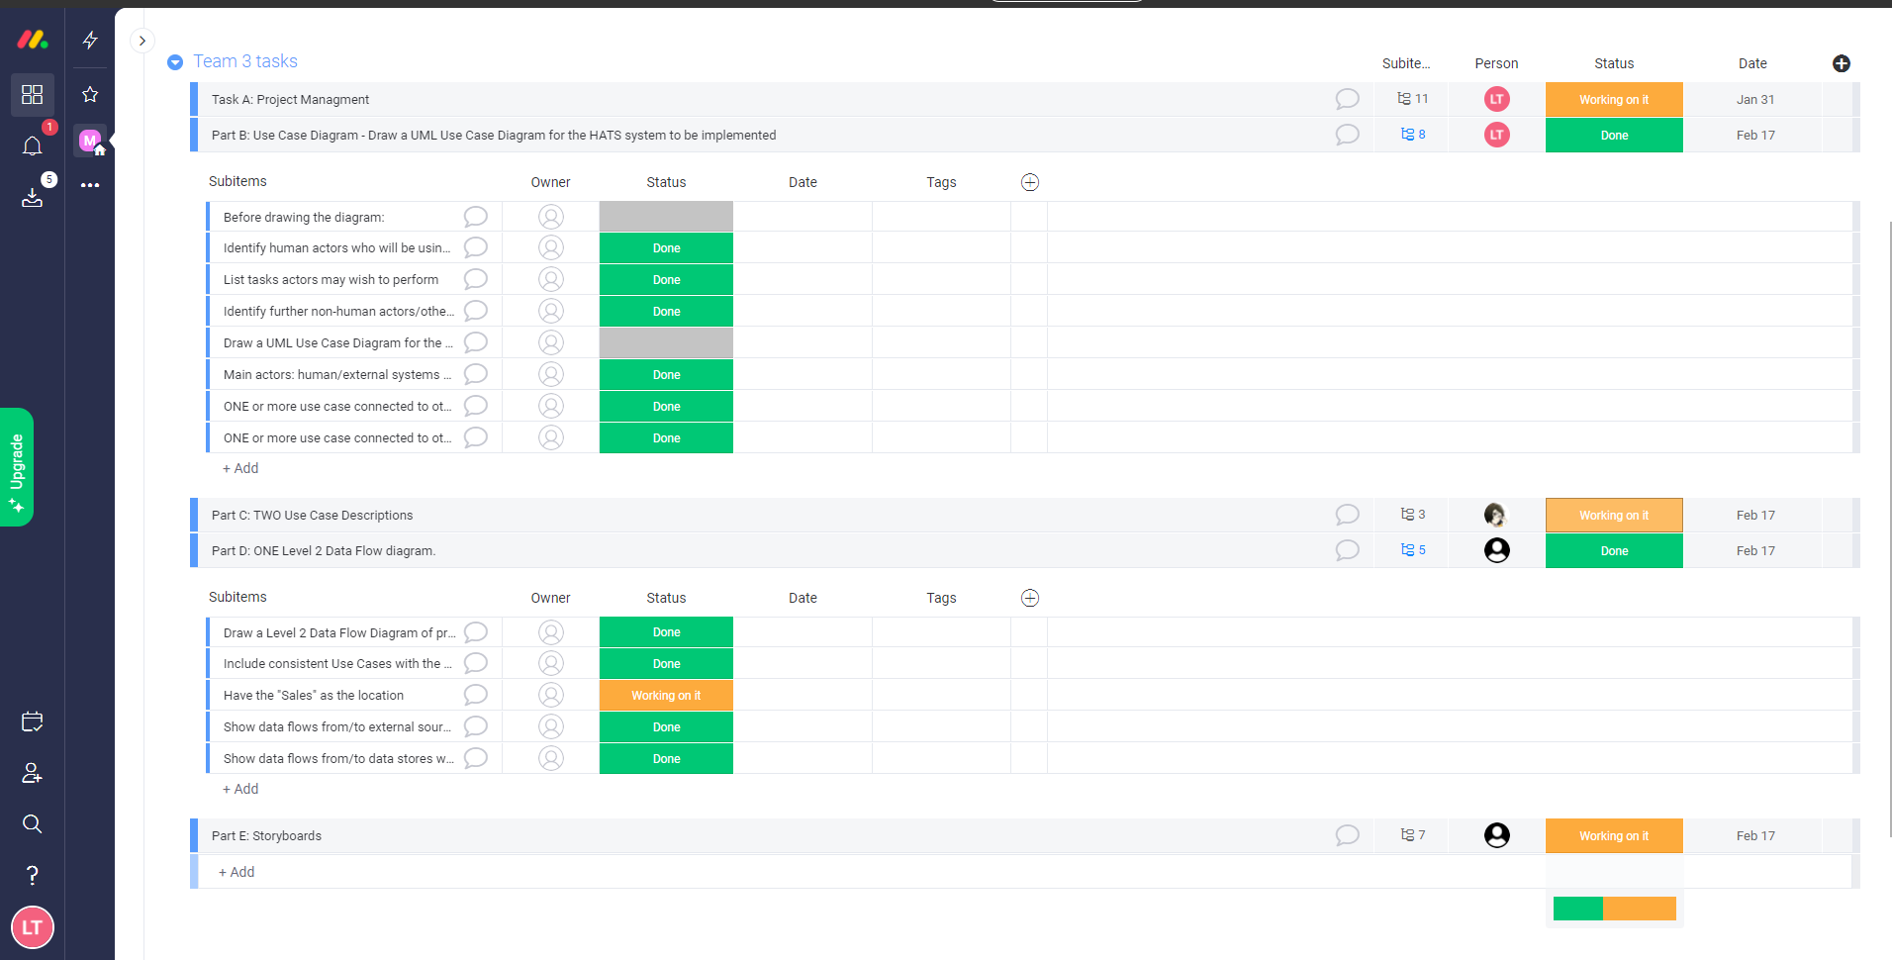
Midterm screen shot showing some completed and some to-be-completed tasks

Slide 12
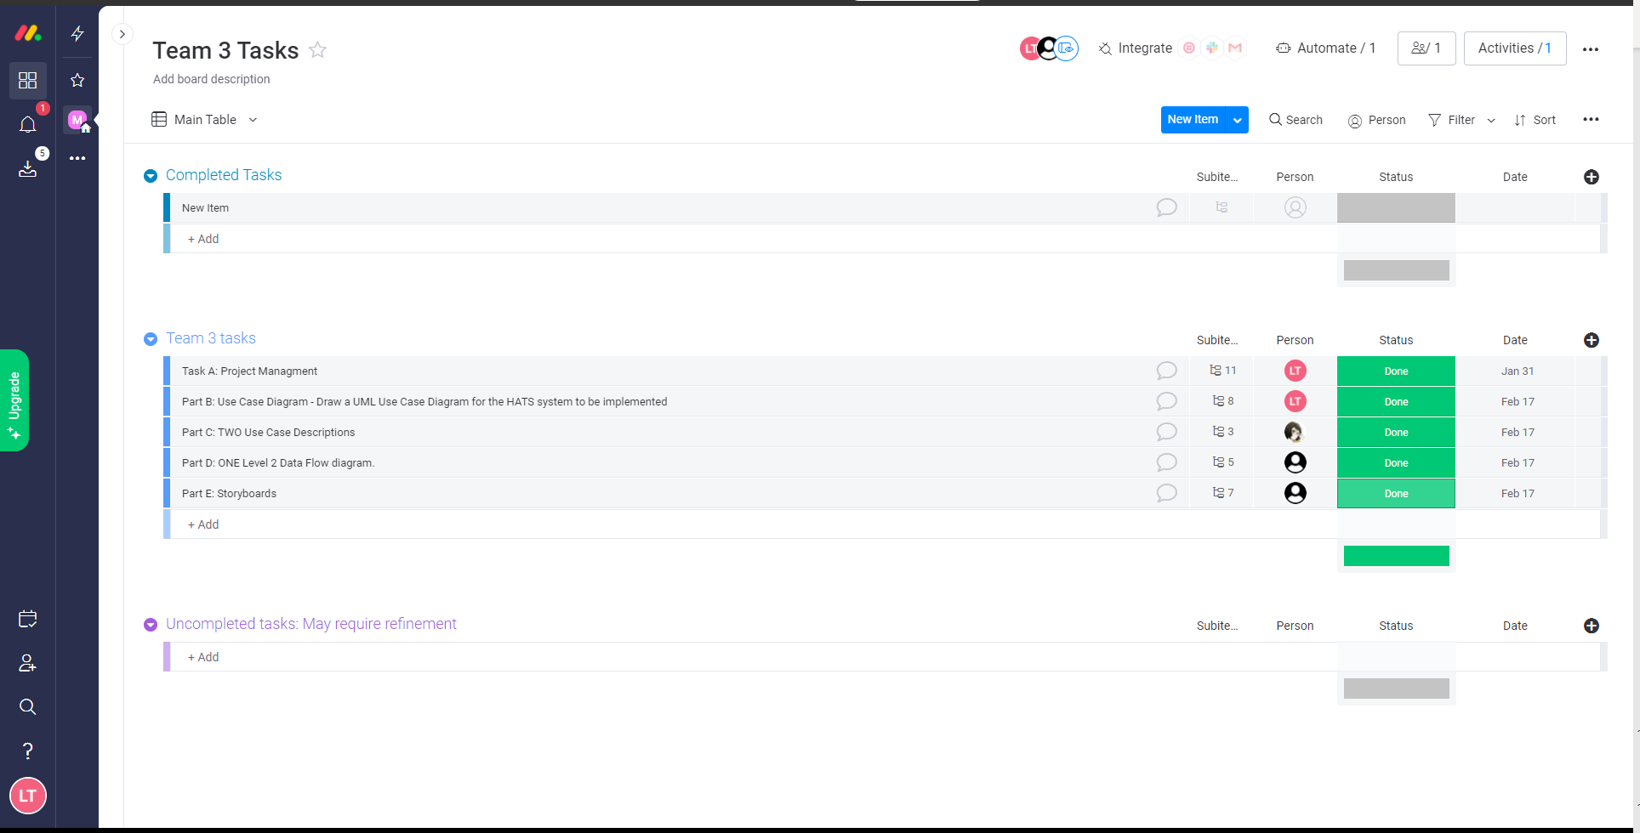
One final screenshot showing completed tasks

Slide 13
Repository

Slide 14
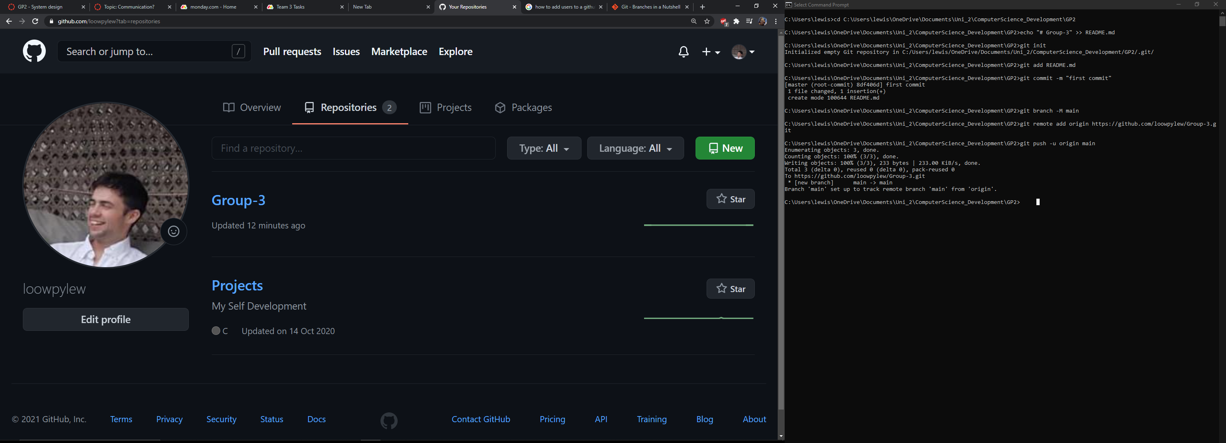
First commit to GitHub Repo, adding a main Branch to echo comment “#Group 3" to mark beginning of first use of GitHub.

Slide 15
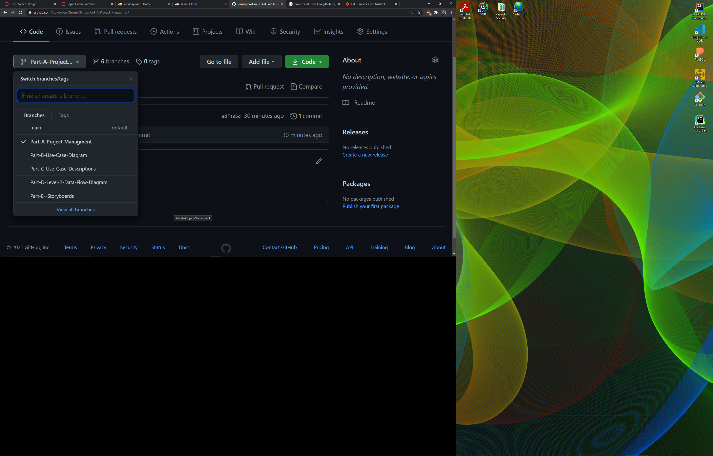
New branches have been created relevant to each part of the assignment for easier management of team members work.

Slide 16
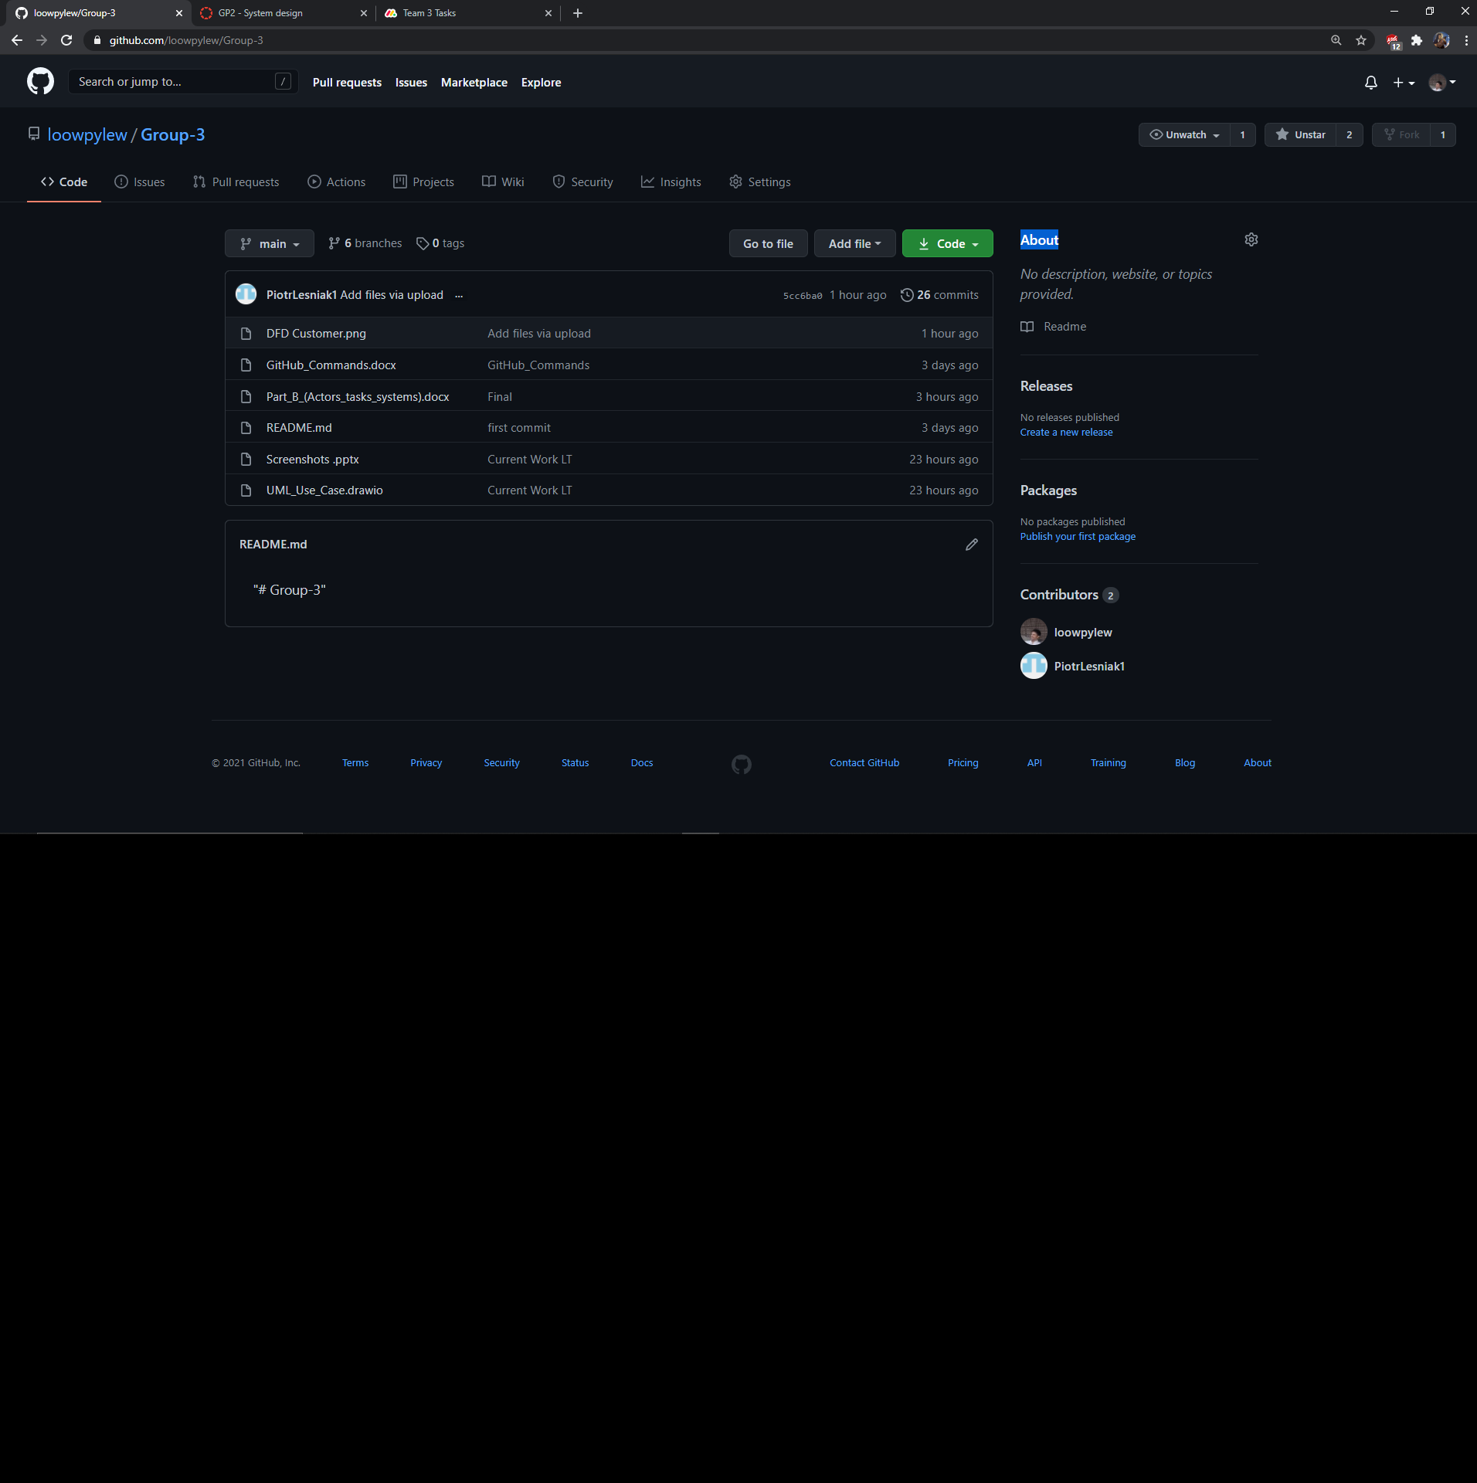
Commits made to the Git Branch with some completed work and some yet to be completed work. In this screenshot, Piotr has recently uploaded a DFD Customer.png file so the rest of the team can view his work for discussion on further improvements.

Slide 17
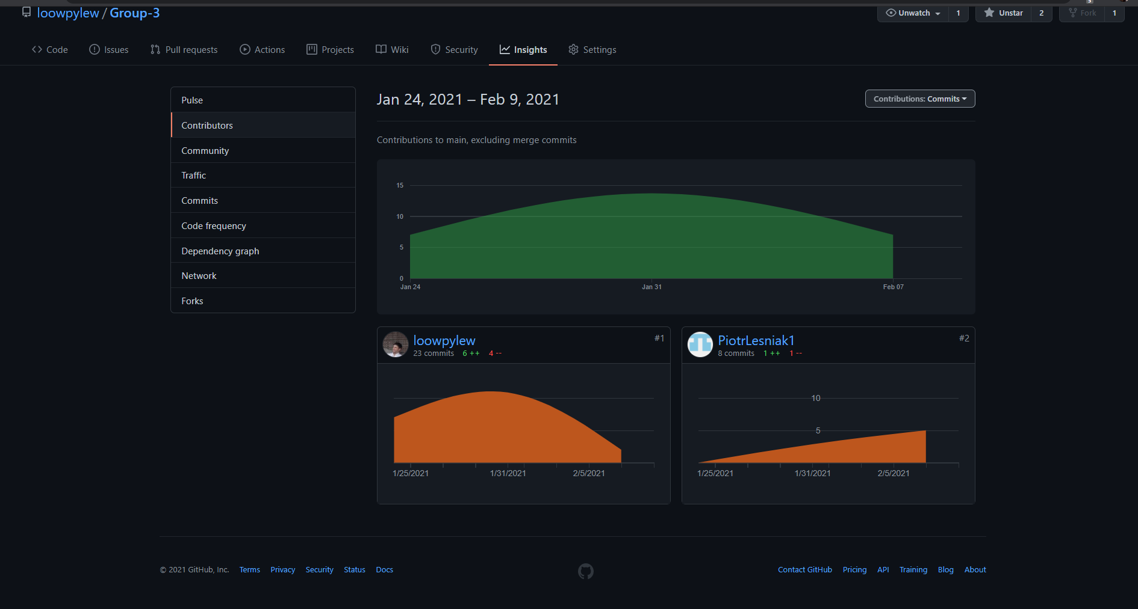
Here is some commit activity from the 24th of Jan to 9th of Feb

Slide 18
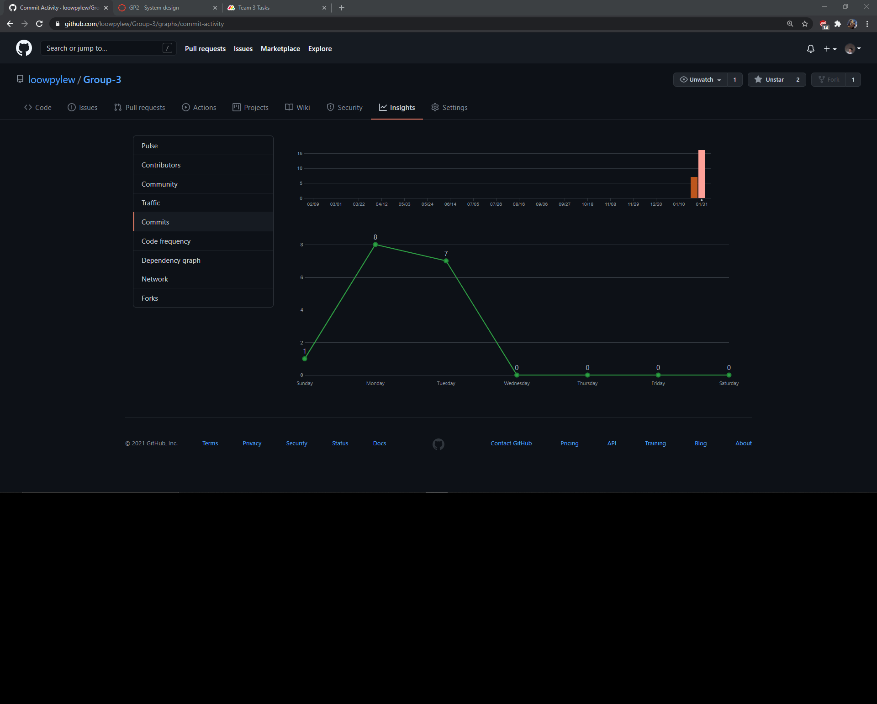
Here we can see activity of commits to files showing proof of further editing

Slide 19
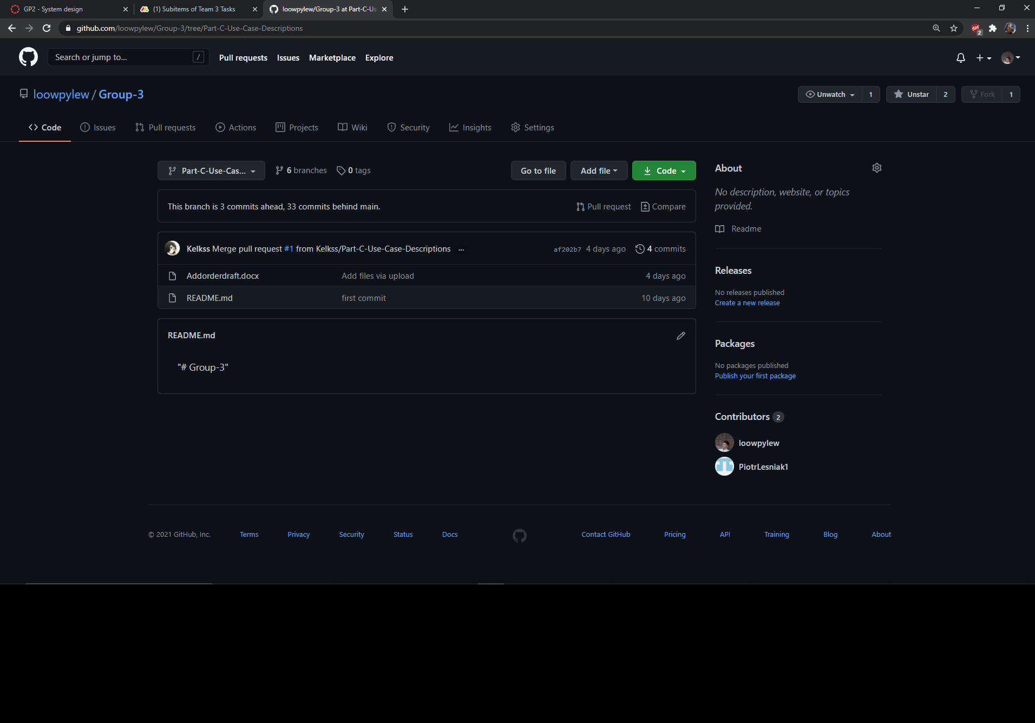
Here, Kellen has uploaded a file to the Part C branch where it will be merged with main once finally complete

